Slide 1
Building node.js Modules
Kevin Griffin
CodeMash 2.0.1.5

Slide 2
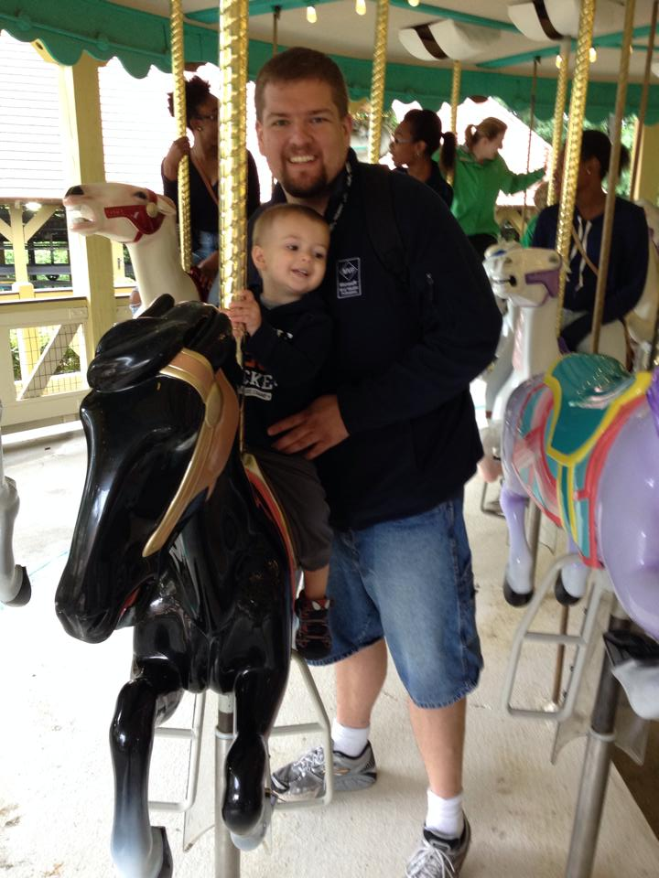
Kevin Griffin
Independent Consultant.
Bootstrapper.
All around nice guy.
kevin@kevgriffin.com
twitter.com/1kevgriff

Slide 3


Simple Windows Server Monitoring
14-day Free Trial
http://winsitter.com

Slide 4

http://wintellectnow.com
Promo Code: GRIFFIN-13

Slide 5
What are modules?

Slide 6
Why modules?

Slide 7
Package Managers

Slide 8
npmjs.org

Slide 9
Three types of modules

Slide 10
require(‘myModule’)

Slide 11
require(‘./myFile’)

Slide 12
require(‘./myFile.js’) or require(‘./myFile.json’)

Slide 13
require(‘./myFolder’)

Slide 14
require(‘./myFolder/index.js’)

Slide 15
Demo: Road to Module Independence

Slide 16
Getting Setup to Publish to npm

Slide 17
Create new user account at npmjs.org
Go to terminal/command prompt
npm set init.author.name "Your Name"
npm set init.author.email "you@example.com"
npm set init.author.url "http://yourblog.com“
npm adduser

Slide 18
npm init npm publish

Slide 19
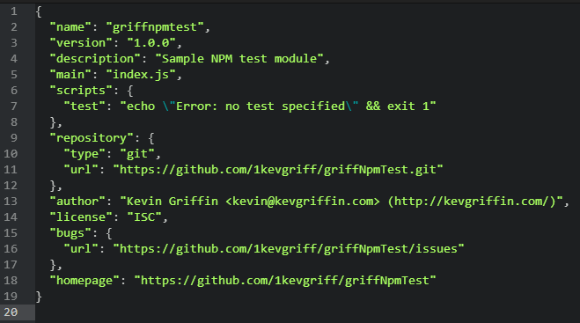

Slide 20
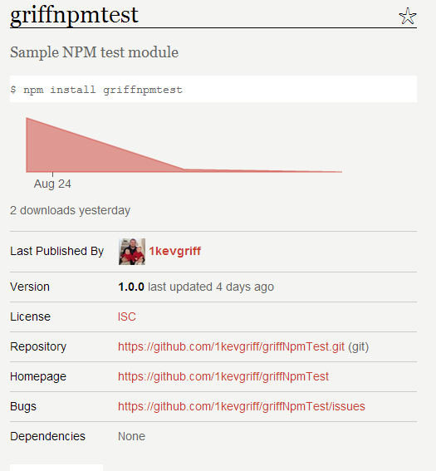

Slide 21
npm publish

Slide 22
And let there be code…

Slide 23
Thanks for attending!
Kevin Griffin
kevin@kevgriffin.com
twitter.com/1kevgriff
http://bit.ly/GriffDevLink1

